Slide 1
(Q) Implement the Boolean function F(A,B,C)=∑(1,3,5,6) with using 4*1 multiplexer.
Drawing truth table according to the question.
INPUTS |  |  |  | OUTPUTS
MINTERM | A | B | C | Y
0 | 0 | 0 | 0 | 0
1 | 0 | 0 | 1 | 1
2 | 0 | 1 | 0 | 0
3 | 0 | 1 | 1 | 1
4 | 1 | 0 | 0 | 0
5 | 1 | 0 | 1 | 1
6 | 1 | 1 | 0 | 1
7 | 1 | 1 | 1 | 0

Slide 2
Implementation table for 4*1 MUX.
A | B | C | Y | Data IN
0 | 0 | 0 | 0 | C
0 | 0 | 1 | 1
0 | 1 | 0 | 0 | C
0 | 1 | 1 | 1
1 | 0 | 0 | 0 | C
1 | 0 | 1 | 1
1 | 1 | 0 | 1 | C’
1 | 1 | 1 | 0

Slide 3
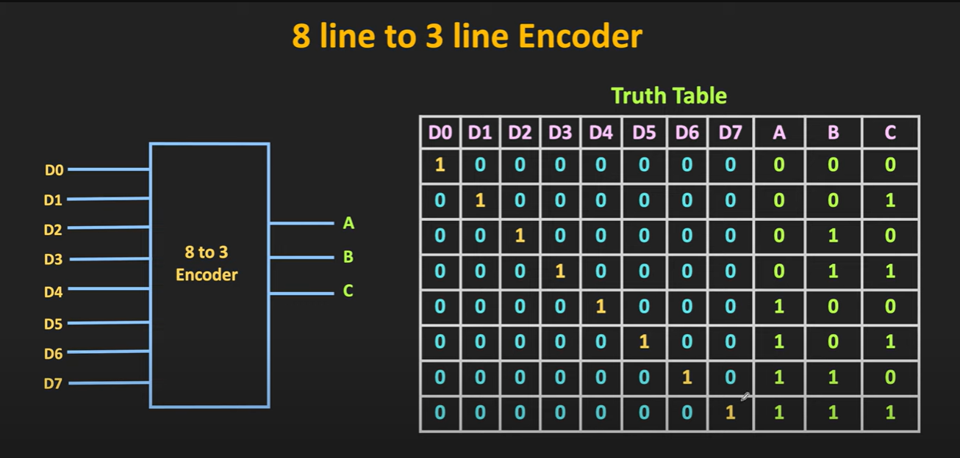

Slide 4
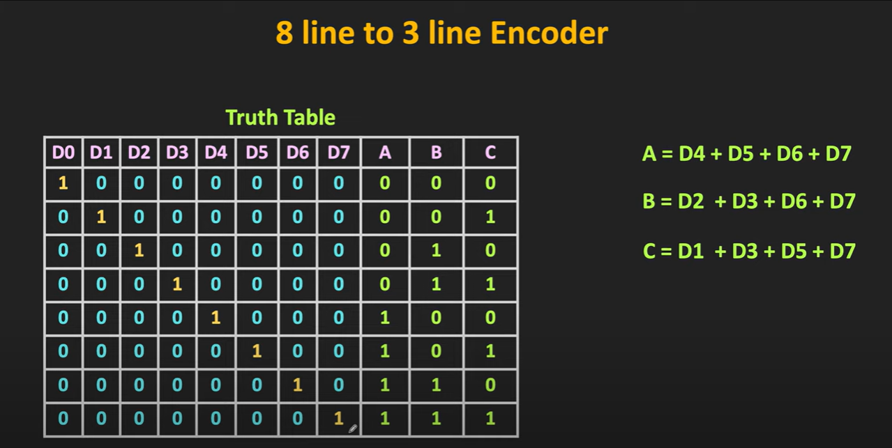

Slide 5
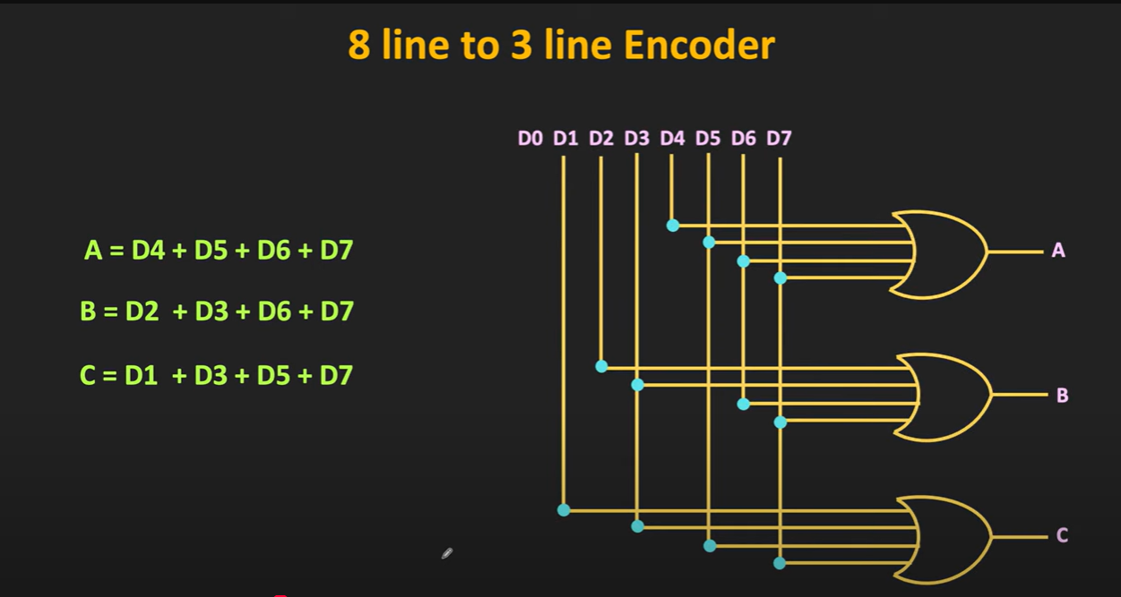

Slide 6
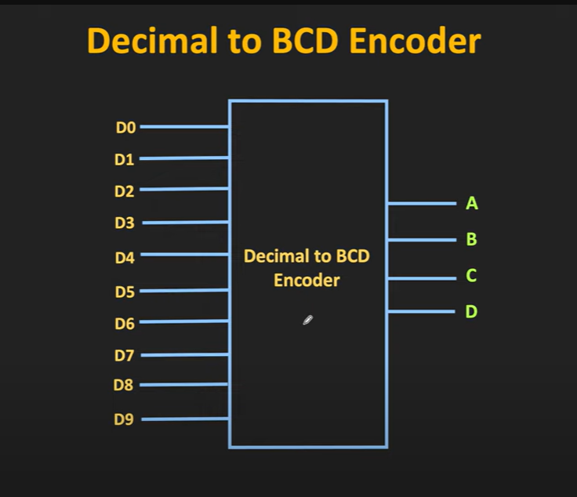

Slide 7
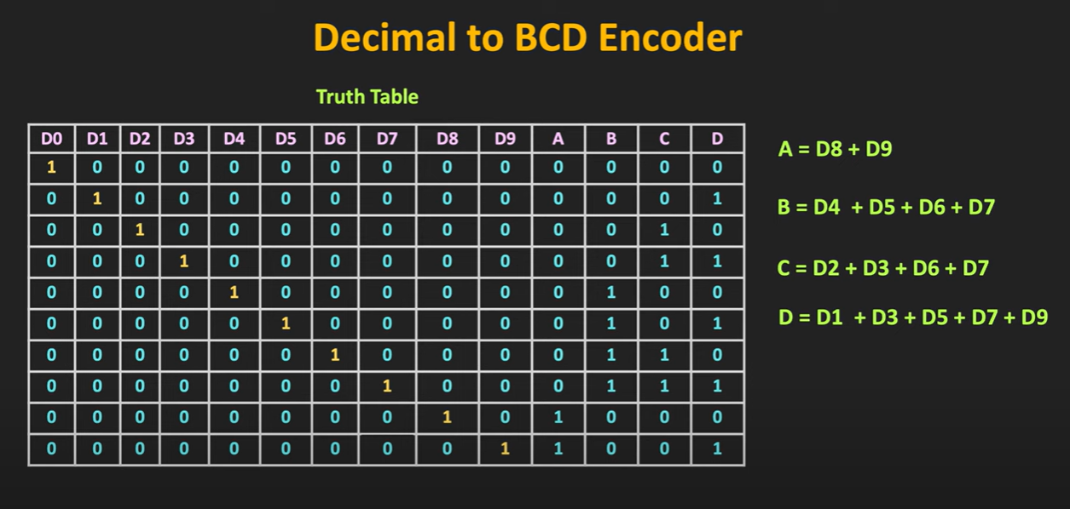

Slide 8
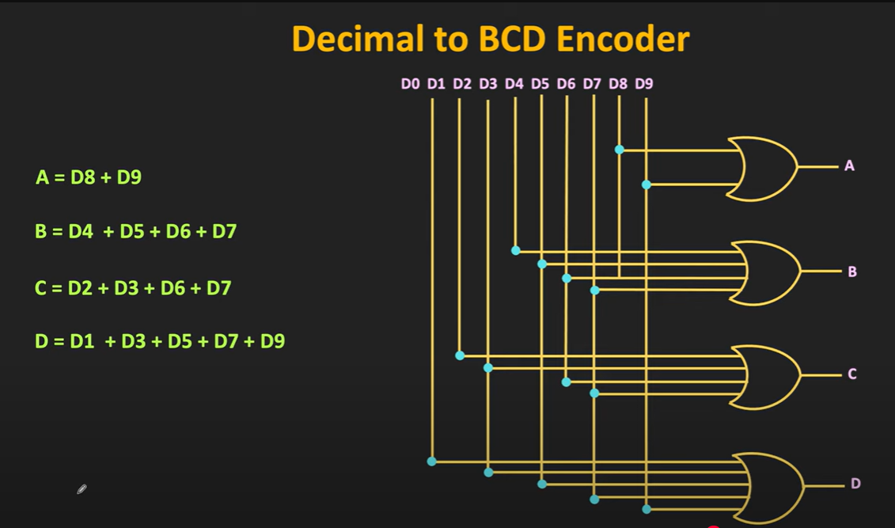

Slide 9
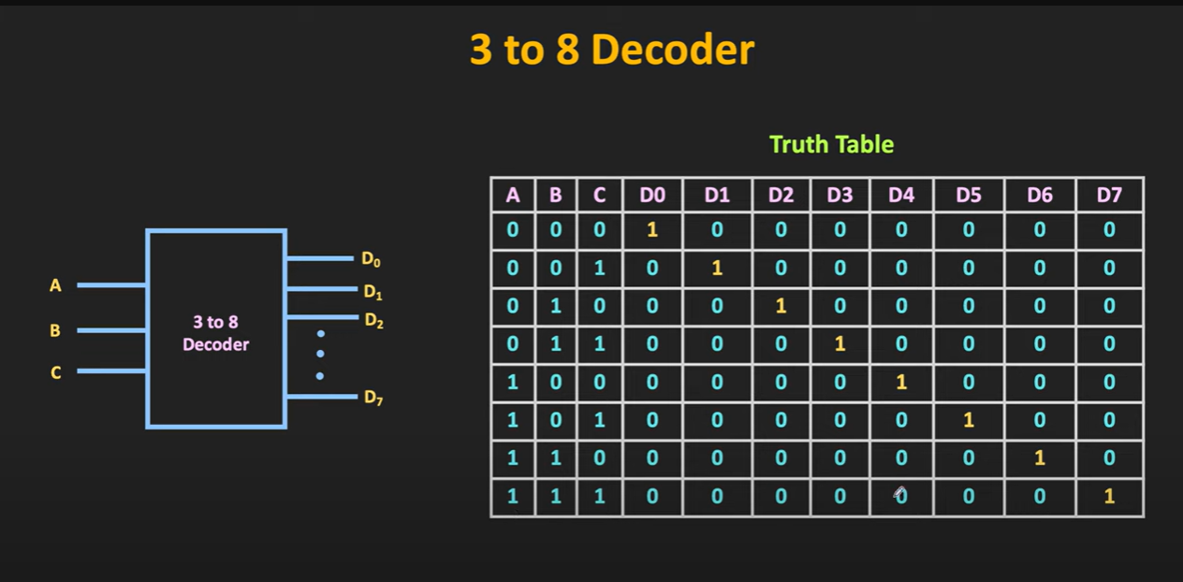

Slide 10
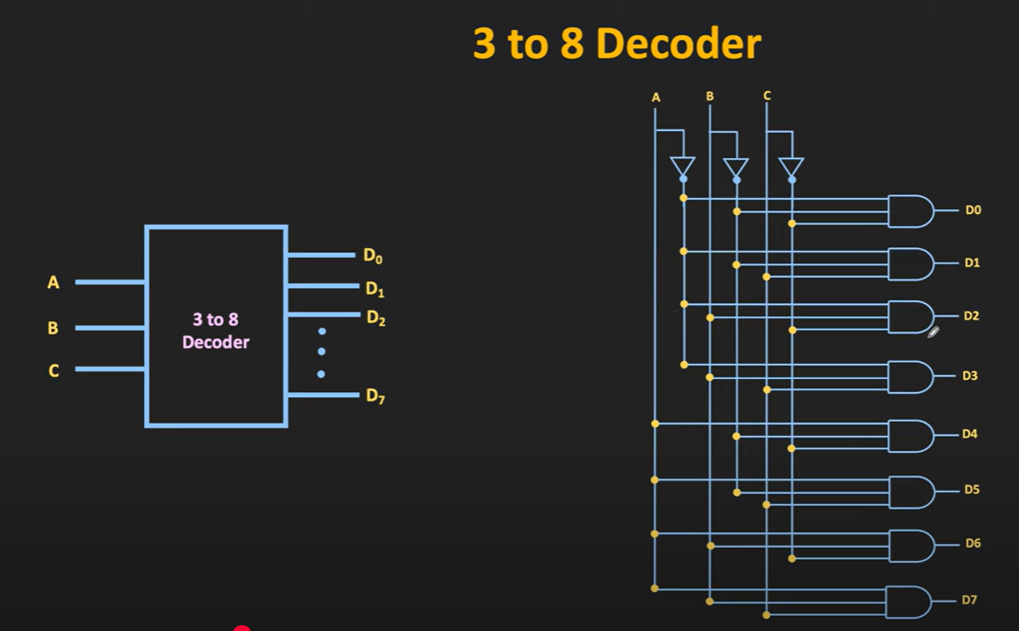

Slide 11
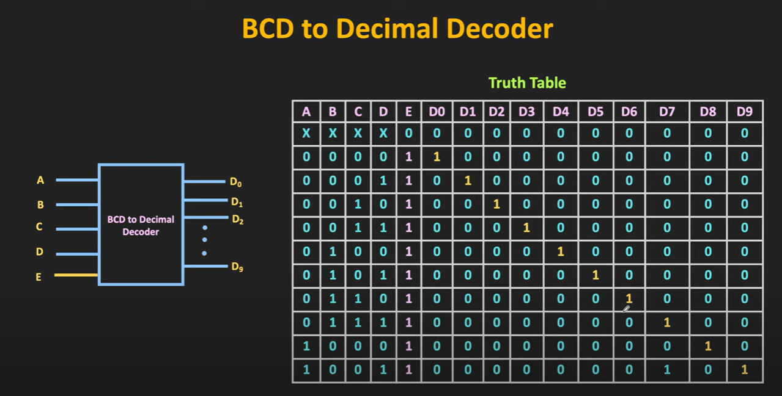

Slide 12


Slide 13


Slide 14


Slide 16


Slide 18
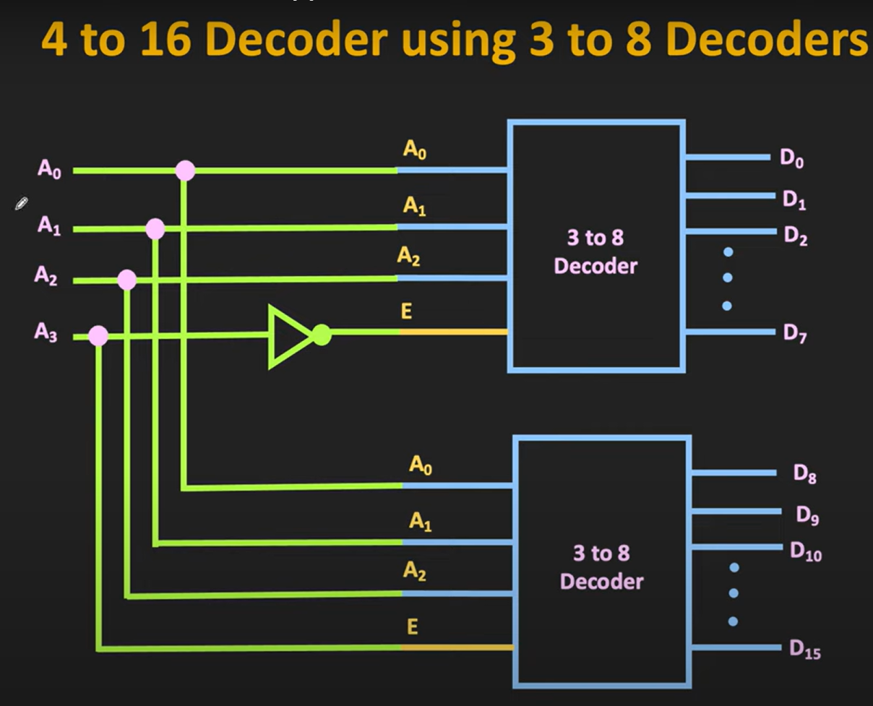

Slide 19
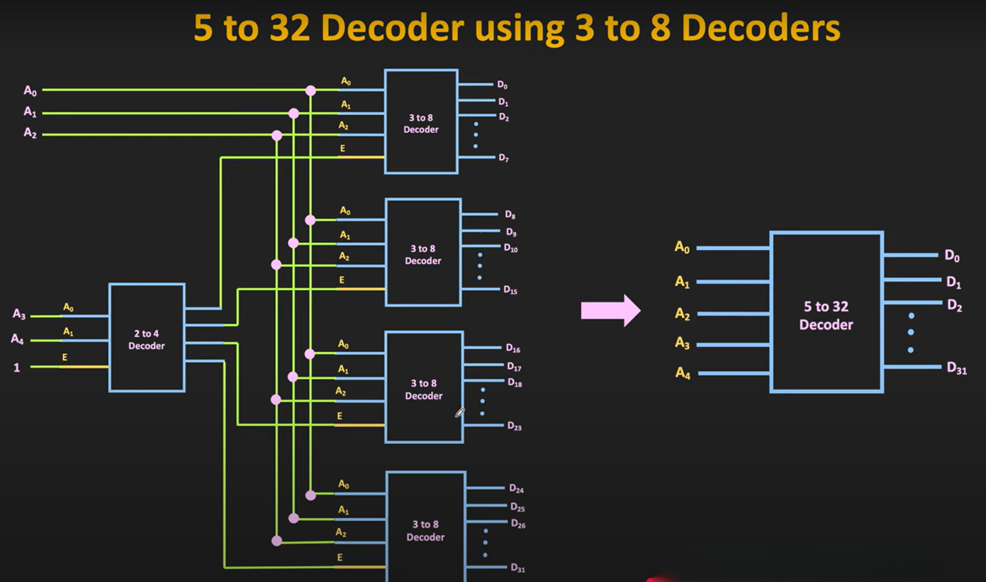

Slide 20
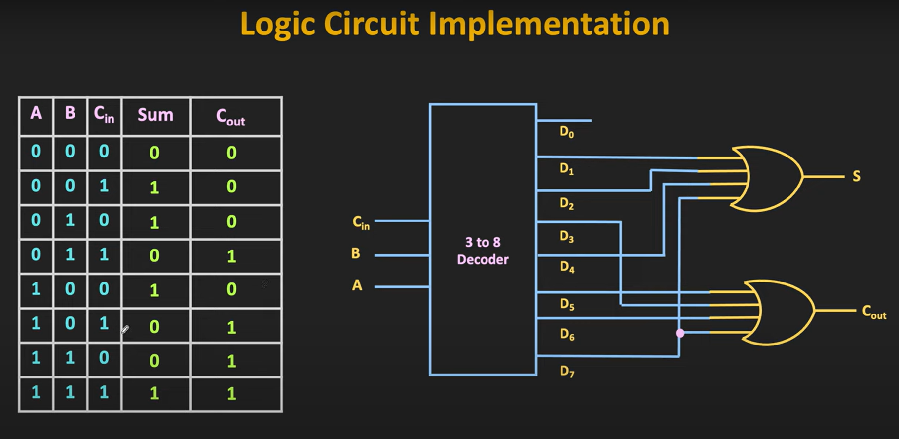
Q) Implement full adder circuit using Decoder

Slide 21
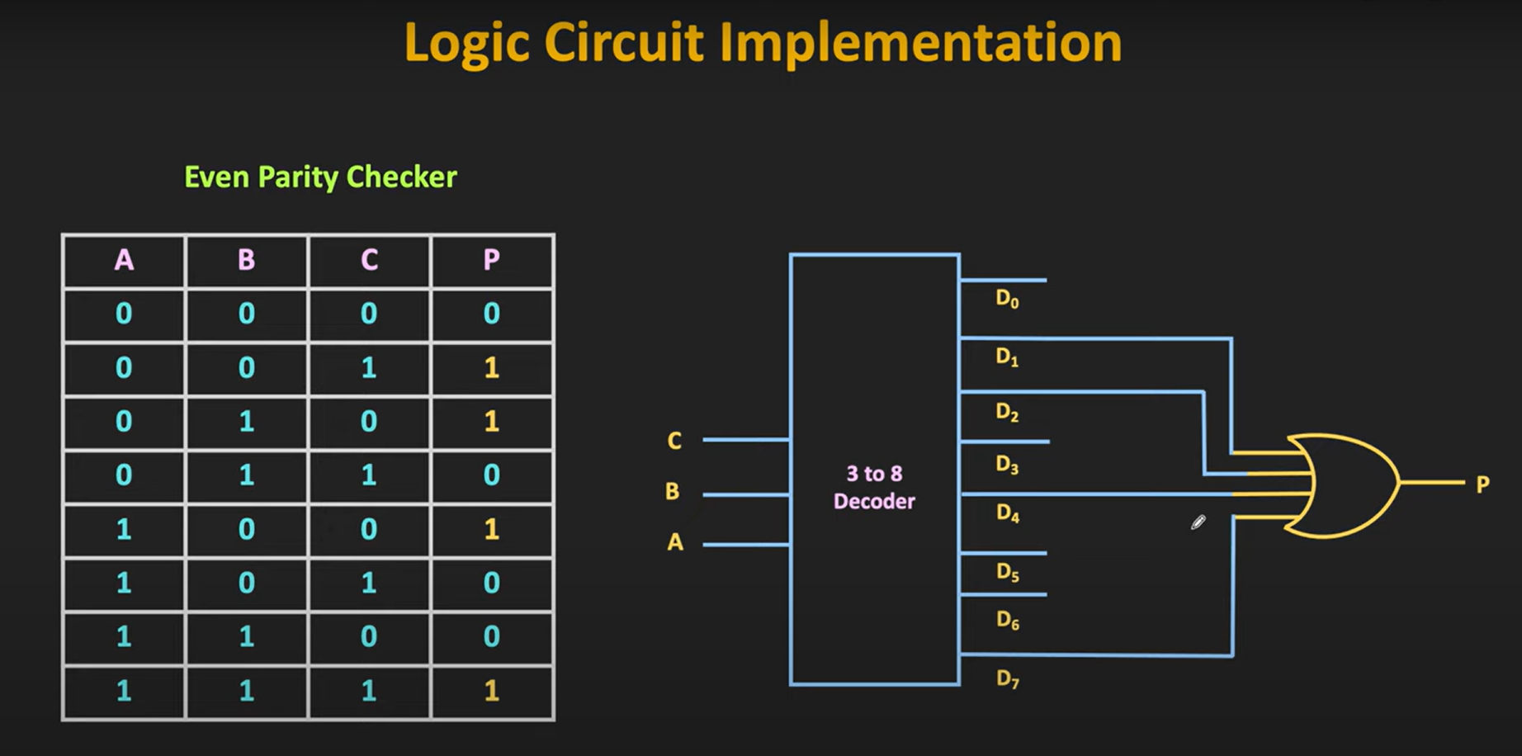
Q) Implement 3 bit even parity checker using decoder

Slide 22
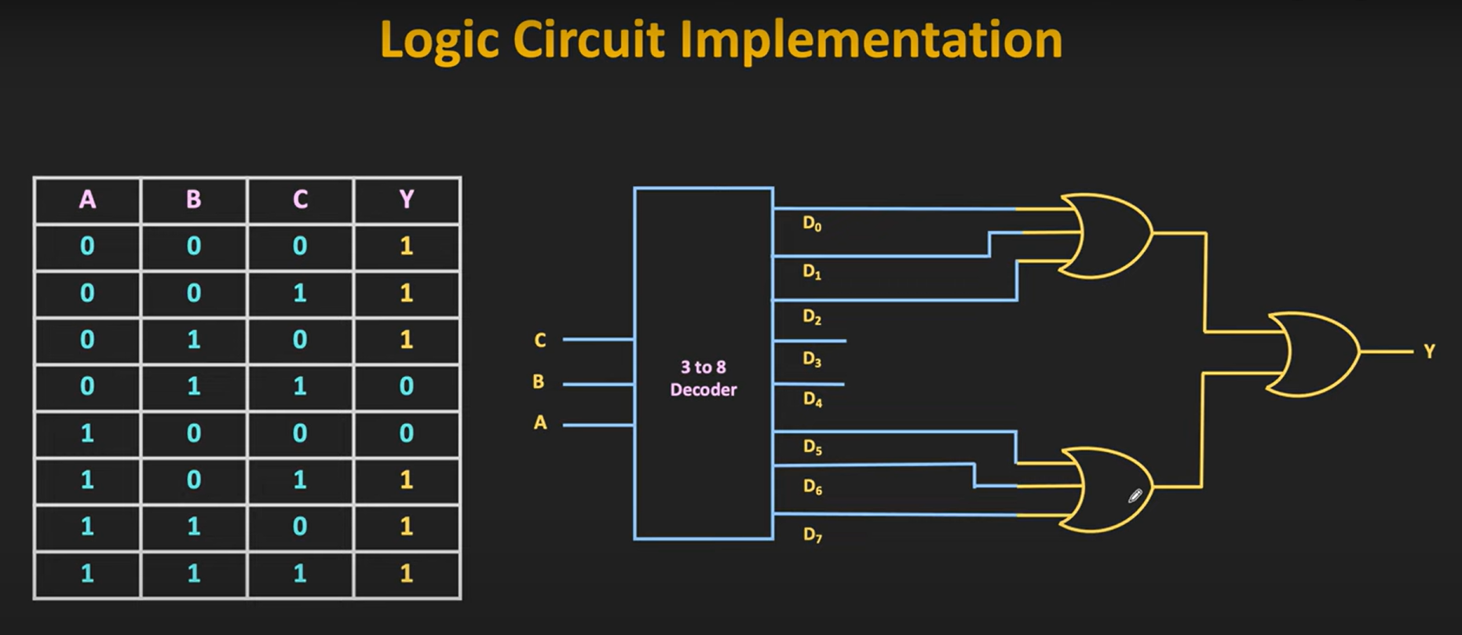
Q) Implement F=(0,1,2,5,6,7) using decoder

